Slide 1



Transformer-Based Sentiment Classification
Names - Falgun Parikh and Jonathan Chacko
Notes:
1

Slide 2
Introduction: Sentiment Analysis
Sentiment analysis, a core NLP sub-discipline, classifies documents by sentiment (positive, negative, neutral). This project focuses on binary sentiment classification of IMDb movie reviews.
Our goals are to evaluate:
Whether Transformer-based models outperform classic ML baselines.
Model behavior using metrics and error analysis (confusion matrices, quantitative, and qualitative).
Notes:
2

Slide 3
Dataset & Preprocessing
Dataset: IMDb Movie Reviews
Preprocessing Steps
50,000 posts tagged as positive or negative.
Lowercasing text
Data Split:
Removing HTML tags and punctuation
Train: 40,000 reviews
Tokenization (WordPiece for Transformers)
Validation: 5,000 reviews
Special tokens ([CLS], [SEP])
Test: 5,000 reviews
Padding and truncation to fixed length
TF-IDF vectorization (max features = 5000) for baselines
Notes:
3

Slide 4
Model Architectures
Transformer-Based Model (BERT)
Baseline Models
Base Model: BERT-base-uncased
Using TF-IDF vectorization, we trained:
Fine-Tuning: Binary output (Dense layer)
Logistic Regression
Optimizer: AdamW
Support Vector Machine (SVM)
Loss Function: Cross-entropy
Multinomial Naive Bayes
Epochs: 3
Random Forest
Batch Size: 16
Evaluation Metrics: Accuracy, Precision, Recall, F1-score
Notes:
4

Slide 5
Results & Evaluation
Transformer (BERT) Performance
Baseline Model Performance (Test Set)
Epoch | Train Loss | Val Loss | Val Acc | Precision | Recall | F1
1 | 0.2747 | 0.2781 | 0.8874 | 0.8416 | 0.9544 | 0.8945
2 | 0.1779 | 0.3077 | 0.8988 | 0.8966 | 0.9016 | 0.8991
3 | 0.1110 | 0.4269 | 0.8992 | 0.8871 | 0.9148 | 0.9007
Model | Accuracy | Precision | Recall | F1
Logistic Regression | 0.8914 | 0.8919 | 0.8908 | 0.8913
SVM | 0.8856 | 0.8900 | 0.8800 | 0.8850
Naive Bayes | 0.8516 | 0.8505 | 0.8532 | 0.8518
Random Forest | 0.8414 | 0.8505 | 0.8284 | 0.8393
Test Set Results: Accuracy: 0.889, Precision: 0.8469, Recall: 0.9496, F1-score: 0.8953
Notes:
5

Slide 6
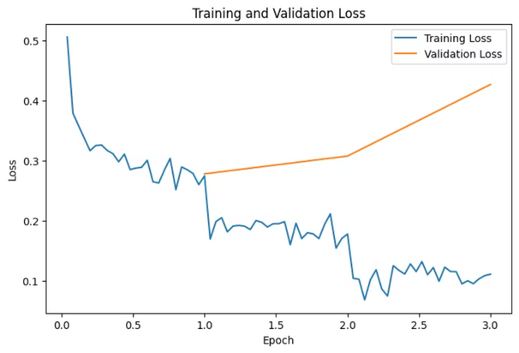
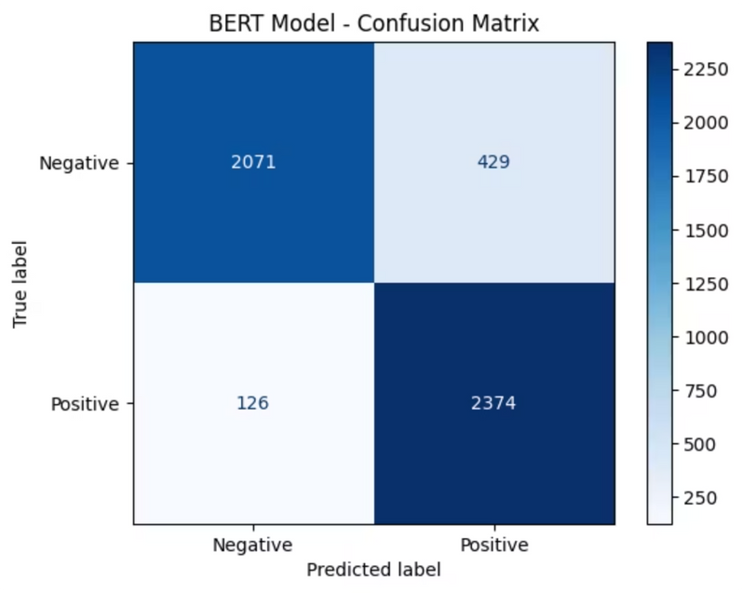
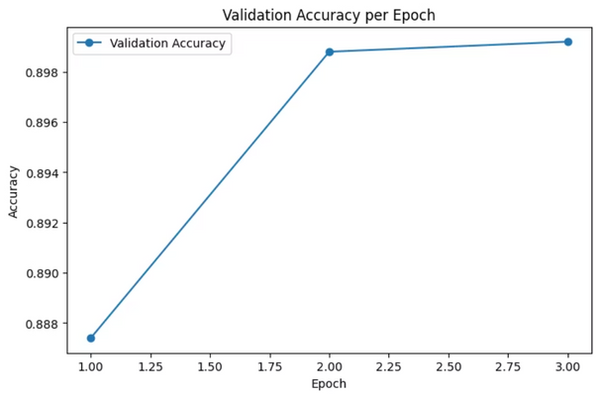
Visualizations
Training and Validation Loss
Confusion Matrix for BERT Model
Loss decreased with training but increased with validation past epoch 2, indicating slight overfitting. Early stopping/regularization is important for better generalization.
Validation Accuracy
Validation accuracy plateaued after epoch 2, implying primary learning occurred early. Additional epochs offered no significant improvement.
The confusion matrix shows balanced false positives and negatives, suggesting the model sometimes misinterprets negative reviews as positive due to snarkiness or subtle criticisms.
True Positives: 2,374
True Negatives: 2,071
False Positives: 429
False Negatives: 126
Notes:
6

Slide 7
Error Analysis
False Negatives
False Positives
Ambiguity
Doubtful, ambivalent, not-so-negative reviews, or those with sarcasm/ mixed sentiments.
Strong negative wording combined with positive proportional ratings in a non-judgmental fashion.
Many mistakes stem from ambiguous meaning rather than just sentiment polarity.
Notes:
7

Slide 8
Discussion
1
Performance Comparison
2
Overfitting
3
Practical Takeaway
BERT showed graphical signs of overfitting past epoch 2. Generalization could be enhanced with early stopping.
For IMDb sentiment classification, domain-standard ML baselines outperform Transformers in accuracy at significantly lower computing costs.
TF-IDF with Logistic Regression slightly outperformed fine-tuned BERT on this dataset. This suggests the IMDb dataset is not overly complex, and BERT's advantage may not be fully realized with limited fine-tuning (3 epochs).
Notes:
8

Slide 9
Conclusion & Future Work
While computationally more costly, fine-tuned BERT's performance is comparable to the best baseline. TF-IDF Logistic Regression remains a powerful and economic alternative.
Future Improvements:
More epochs for fine-tuning with early stopping.
Data augmentation for better generalization.
Exploring domain-expert Transformers like DistilBERT or RoBERTa.
Notes:
9

